Slide 1
Smart light
Smart light is aiming to light on a room only when it’s needed :
When the room is dark and when people are inside.
If someone goes inside the room on daylight nothing happens

Slide 2
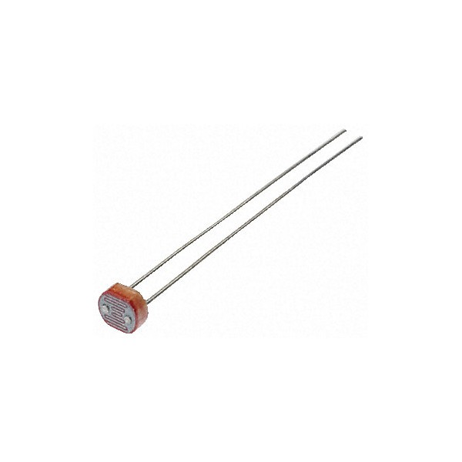
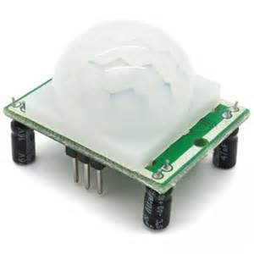
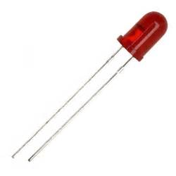
Smart light
For a model of the project i used :
A led simulating the light of a room
A PIR sensor detecting people inside the room
A light sensor detecting if it’s day or night

Slide 3
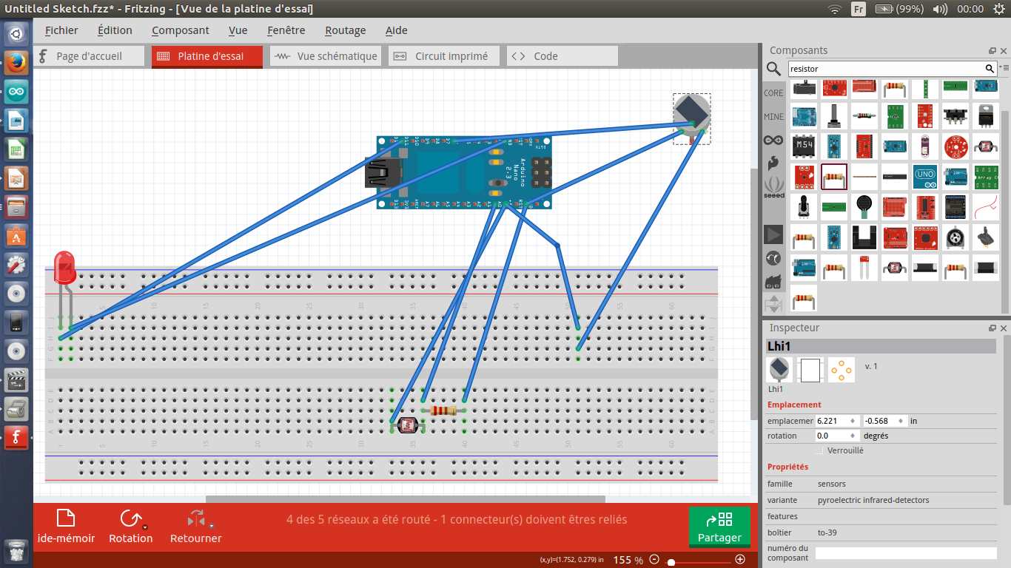
Smart light

Slide 4
Smart light
Graphic interface :
We could improve the project with a graphic interface that could control the brightness of the light as we wish.

